Slide 1
EPIDEMIOLOGY, ETIOLOGY & PREVENTION OF ORAL CANCER
K. Monisha Aishwarya
3rd year Postgraduate
Dept. of Public Health Dentistry

Slide 2
CONTENTS
Introduction
Terminology
Classification of Oral Cancer
Epidemiology of Oral Cancer
– Global and Indian Scenario
Etiology of Oral Cancer
– Agent, Host & Environmental factors
Prevention of Oral Cancer
Conclusion
References

Slide 3
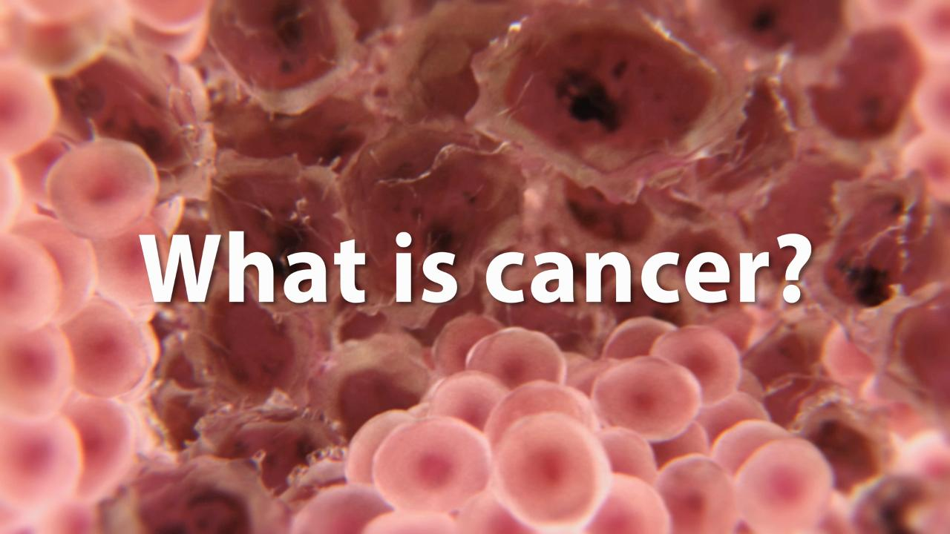

Slide 4
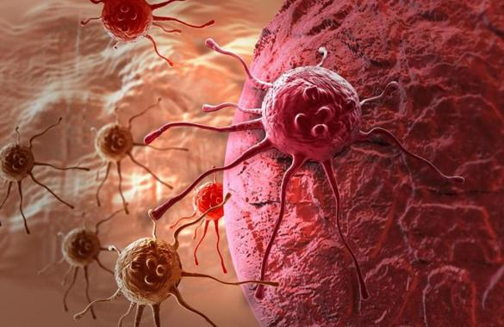
Introduction
CANCER may be regarded as a group of diseases characterized by
An abnormal growth of cells.
Ability to invade adjacent tissue and even distant organs.
The eventual death of the affected patient if the tumor has progressed beyond that stage when it can be successfully removed.
CANCER is defined as an abnormal, excessive, unwanted, uncontrolled and uncoordinated growth of cells which continue to proliferate even after the removal of the causative stimulus.
American Cancer Society
Malignancy
Neoplasm

Slide 5
Terminology
Carcinoma: which arise from the epithelial cells lining the internal surfaces of the various organs.
e.g. Oral cavity, esophagus, intestines, uterus, skin epithelium.
Sarcomas: which arise from mesodermal cells constituting the various connective tissues.
e.g. Fibrous tissue, fat, bone.
Lymphomas, myeloma, and leukemia arising from the cells of bone marrow and immune systems.

Slide 6
ORAL CANCER:
Used to describe any malignancy that arises from oral tissues.
ORAL PRECANCER:
Intermediate clinical state with increased cancer risk, which can be recognized and treated, obviously with a much better prognosis than a full blown malignancy.

Slide 7
Pre- malignant lesion: “Morphologically altered tissue in which cancer is more likely to develop than its apparently normal counter part”.
e.g Leukoplakia, Erythroplakia, Palatal changes associated with reverse smoking.
Pre malignant condition: “A generalized disturbance or a disease state, which predisposes to the development of a neoplasm at a particular site”.
e.g. Submucous fibrosis, Lichen planus, DLE, actinic keratosis

Slide 8
POTENTIALLY MALIGNANT DISORDERS:
According to a workshop coordinated by World Health Organization (WHO) in May 2005 at London, the use of the term ‘Potentially malignant disorders’ was recommended.
The usage of this terminology conveys that not all lesions and conditions described under this term may transform to cancer, instead there is a family of morphological alterations amongst which some may have an increased potential for malignant transformation.
Asian Pacific J Cancer Prev 2012; 13: 1633-1637.

Slide 9

CLASSIFICATION OF ORAL CANCER
Epithelial origin
Benign tumours
Premalignant lesions
Malignant tumours
Papilloma
Squamous acanthoma
Keratoacanthoma
Pigmented cellular nevus
Leukoplakia
Leukoedema
Erythroplakia
Oral Submucous Fibrosis
Lichen Planus
Basal cell carcinoma
Epidermoid carcinoma
Spindle cell carcinoma
Adenoid squamous cell carcinoma
Lymphoepithelioma
Malignant melanoma

Slide 10
CLASSIFICATION OF ORAL CANCER
Connective tissue origin
Benign tumours
Malignant tumours
Fibroma
Giant cell Fibroma
Peripheral Central Ossifying Granuloma
Lipoma
Hemangioma
Myxoma
Chondroma
Benign Chondroblastoma
Osteomas
Fibrosarcoma
Liposarcoma
Kaposis Sarcoma
Ewings Sarcoma
Chondro/Osteosarcoma
Non-Hodgkins Lymphoma
Burkitts Lymphoma
Multiple Myeloma

Slide 11
RED AND WHITE LESIONS
WITH DEFINED PRECANCEROUS POTENTIAL
Leukoplakia
Erythroplakia
Oral lesions associated with use of tobacco & alcohol
Carcinoma-in-situ
Bowen’s disease
Oral Submucous fibrosis
Actinic keratosis
Discoid Lupus Erythematosis
Dyskeratosis congenita
Lichen Planus
Lichenoid reactions

Slide 12
According to International Classification Of Diseases WHO 9th version:
Oral cancer is classified under the rubrics
Lip- 140
Tongue- 141
Cheek- 142
Gingiva – 143
Floor of the mouth- 144
Other parts of the mouth- 145

Slide 13

EPIDEMIOLOGY
Global Scenario Of Oral Cancer
Cancer is one of the major threats to public health in the developed world and increasingly in the developing countries.
Oral cancer is one of the 10 most common cancers in the world.
Oral cancer is more prevalent in developing Southeast Asian countries like India, Srilanka, Indonesia & Pakistan.
It is estimated that during the year 2012 , about 2.6L new cases and 1.27L deaths occurred world wide with a mortality rate of 1.9 per one lakh’ population. (GLOBOCAN 2012)

Slide 14
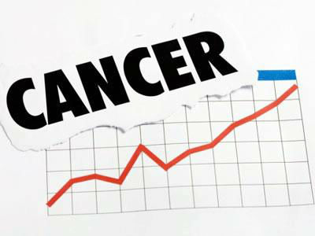
Indian Scenario:
Cancer registration in India
Until 1964, no information on cancer occurrence in India was available
In 1982, National Cancer Registration Program (NCRP) was commenced by ICMR with a network of cancer registries across the country.
Objectives of NCRP
To generate reliable data on the magnitude and patterns of cancer.
Undertake epidemiological studies based on results of registry.
Help in designing, planning, monitoring and evaluation of cancer control activities.
Develop training programs in cancer registration and epidemiology.

Slide 15

Spectrum Of Oral Cancer In India
India has the highest incidence of oral cancer in the world.
Ranks number one among males and three among females in India.
Constitutes 12% of all cancers among males and 8% of all cancers among females.
For the year 2012
Incidence of oral cancer – 9.8 cases per 100,000 males
5.2 cases per 100,000 females
Mortality - 6.8 per 100,000 among males
3.6 per 100,000 among females
Number of new cases registered in India was 69,820 with 47,653 deaths due to oral cancer (GLOBOCAN 2012, India Facts Sheet)

Slide 16

EPIDEMIOLOGICAL STUDIES:
Authors | Findings
Kumar BD et al; 2016 | A review of literature showed that the prevalence of Oral Submucous Fibrosis (OSF) in India varies between 0.03% and 3.2% with a higher risk of cancer. Prevalence of leukoplakia and oral lichen planus in India varies from 0.2%-5.2% and 0.02%-0.4% respectively.
Sridharan G; 2012 | Leukoplakia : 0.2 to 5.2%; OSMF: 0.03 to 3.2% Erythroplakia: 0.02 to 0.6%; OLP: 0.5 to 2.2%
Mehrotra R et al; 2008 | Majority of the tobacco users – OSMF followed by dysplasia
Gowhar O et al; 2016 | 200 oral biopsies: 130 premalignant & 40 malignant lesions OLP & OSMF

Slide 17

ETIOLOGY
ESTABLISHED RISK FACTORS
Dietary deficiency (Vit A,C,E, Iron)
Genetics
Sunlight
Dental trauma
Viral infection
Air pollution & environmental exposure to the burning of fossil fuels
Chronic sepsis in the mouth
Chemical agents
PREDISPOSING FACTORS
Smoking tobacco
Chewing tobacco/oral snuff
Heavy consumption of alcohol
Presence of potentially malignant lesions
Prior history of oral cavity/other aerodigestive tract cancer
Age, in conjunction with other risks listed

Slide 18
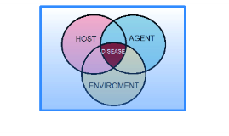
ETIOLOGY
HOST FACTORS
USE OF ALCOHOL
USE OF TOBACCO
OCCUPATION
FAMILIAL AND GENETIC PREDISPOSITION
NUTRITION AND DIET
SITE
ETHNIC VARIATION
SEX
AGE
AGENT FACTORS
PHYSICAL AGENTS
CHEMICAL AGENTS
MECHANICAL AGENTS
BIOLOGICAL AGENTS
NUTRITIONAL AGENTS
ENVIRONMENTAL FACTORS
AIR POLLUTION
INDUSTRIALIZATION
OCCUPATIONAL ENVIRONMENT

Slide 19

HOST FACTORS
Age:
Cancer is an age related disease.
Studies have reported maximum prevalence in the 5th and 6th decade of life.
Approximately 96% of oral cancer is diagnosed in persons older than 40 years and above.
More than 50% of all cancers occur in persons over the age of 65 years.
PLoS Med 2006;3(11):442

Slide 20
During the previous two decades, in many western countries there has been an alarming rise in the incidence of neoplasm among young men, a trend that seems to be continuing.
Recently, evidence has emerged indicating that oral cancers are occurring more frequently in younger persons (less than 40 years).
Community Dent Oral Epidemiol 2002;30:277–285.

Slide 21
  SEX: Males> Females
  In males, it varied from 36.1% in Bangalore to 54.6% in Bhopal.
  In females, Bangalore and Mumbai have the highest proportion of 17.2% and 16.3% respectively.
  Sharma P et al revealed a male to female ratio of 2.2:1 for the prevalence of oral cancer among people of Uttar Pradesh.
  Indian J Dent Res 2012; 28 (4), 465-469
  Mehrotra R et al → 2.4:1
  Asian Pacific J Cancer Prev 2008;9:263-266.

Slide 22
Site distribution:
  Squamous cell carcinoma is the most common type of malignant neoplasm affecting the oral cavity.
  Although the occurrence may be at any intraoral site, certain sites are more frequently involved than the other sites.

Slide 23
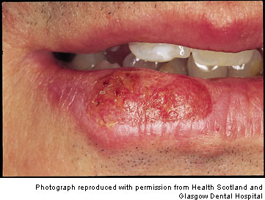
a) Cancer of lip:
Commonly found in elderly men.
Lower lip commonly involved.
Etiology:
Smoking- pipe smoking
Consumption of alcohol
Exposure to sunlight
Syphilis
Poor oral hygiene

Slide 24
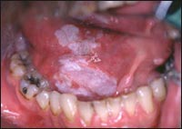
b) Floor of the mouth :
Constitute approximately 15% of all cases of intra oral cancer.
Not a common location for cancer in India.
Etiology:
Smoking- pipe smoking
Consumption of alcohol
Poor oral hygiene

Slide 25
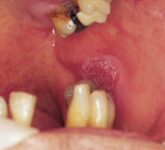
c) Buccal mucosa:
Most common cancer in India.
Usually seen in relation to plane of occlusion.
Etiology:
Chewing tobacco and retaining the tobacco quid.
Poor oral hygiene.
Chronic trauma and irritation caused by a sharp tooth.

Slide 26
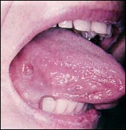
d) Tongue:
Most frequent site after buccal mucosa.
In India it accounts for 50% of oral cancer in males, and 27% in females.
80% occur on the anterior 2/3rd and lateral margins and ventral surface.
Etiology:
Smoking (Bidi), Chewing tobacco and retaining the tobacco quid
Poor oral hygiene
Chronic trauma and irritation caused by a sharp tooth.

Slide 27
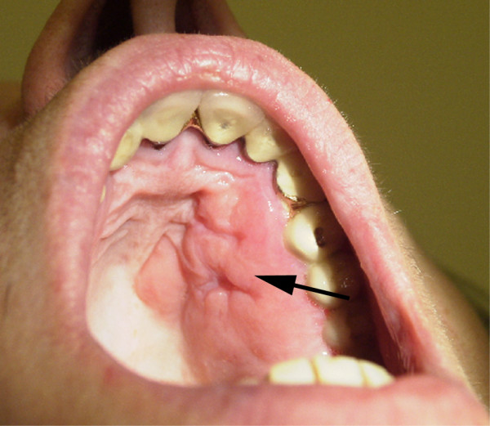
e) Palate:
Hard palate (central part) most common
Ulcer less frequent; exophytic growth seen usually.
Metastasis may occur to maxillary sinus, nasal cavity.
Etiology:
Smoking, especially seen in reverse smokers.

Slide 28
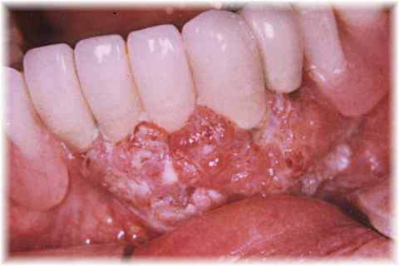
f) Gingiva:
10% of oral cancer in men and 16% among women.
Common in maxillary attached gingiva (4%)
Metastasis is rapid.
Carcinoma of alveolar ridge invades the mandible in 56% of all cases as compared to 19% of carcinoma of buccal mucosa.
Etiology:
Chronic irritation and inflammation due to calculus accumulation for several years.
Poor oral hygiene,
Post extraction - develops rapidly and proliferate up out of the socket.

Slide 29
The most common sites in the oral cavity
Buccal mucosa - 63.75%
Retro molar area - 15%
Floor of the mouth -11.25%
Lateral border of the tongue- 3.75%
Labial mucosa- 3.75%
Palate- 2.5%

Slide 30
OCCUPATION:
Certain occupations where exposure to carcinogens is common like tar manufacturing, certain oils and textile industries, the workers are susceptible to cancer.
Leather workers are shown to have higher rate of cancer of buccal cavity.
Adv Prev Med 2015;19:1-7.
SOCIO-ECONOMIC STATUS:
Oral cancers are common in lower socio-economic status than higher socio-economic status people.
Natl J Maxillofac Surg 2014; 5(2): 142–148.

Slide 31
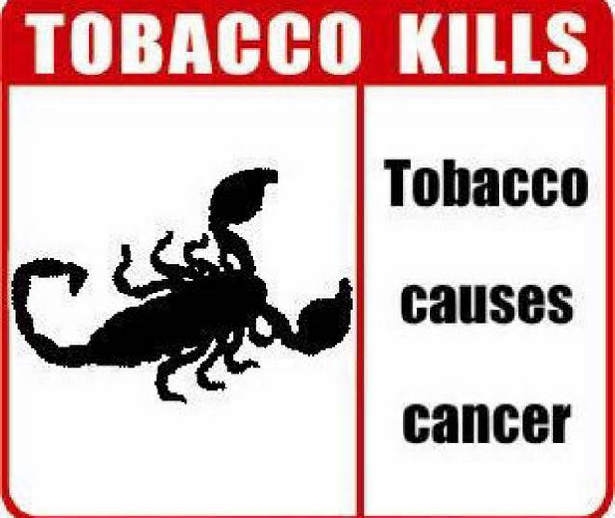
HABITS:
Tobacco use:
Smoking tobacco
Smokeless tobacco – chewing tobacco and snuff.
Tobacco was introduced into Europe in the late 15th century.
In the late 16th century or early 17th century, Portuguese traders introduced it into India.
Since then tobacco use has spread with remarkable rapidity, seeping into all sections of the society.
Notes:
sabiha

Slide 32
Initially tobacco was smoked in India, but later it was used in chewing and application over the teeth and gingiva.
In the course of time, large spectrums of methods of use were developed.
J Clin Diagn Res 2016;10(5):13-7
It is estimated that among the 400 million individuals aged 15 years and over in India, 47% use tobacco in one or the other form.
72% of tobacco users smoke beedis,
12% smoke cigarettes and
16% use tobacco in smokeless form.

Slide 33
CONSTITUENTS OF TOBACCO
CONSTITUENTS | ADVERSE EFFECTS
Poly aromatic hydro carbon | Carcinogenesis.
Nicotine | Potential carcinogenic agent
Phenol | Ganglionic stimulation and depressions Tumour promotion
Benzopyrene | Tumour promotion Irritation
Carbon monoxide | Impaired oxygen transport and repair.
Nitrosamine | Potential carcinogenic agent.

Slide 34
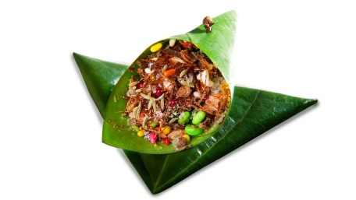
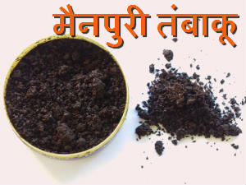
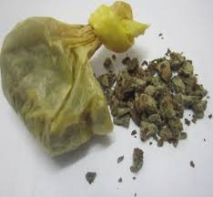
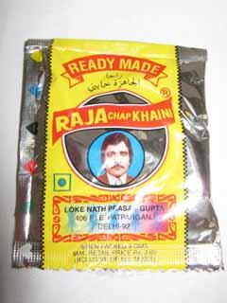
Chewing Habits | Ingredients | Significance
Pan | Betel leaf, Areca nut, Slaked lime and Catechu (Aracia catechu) | Mostly preferred after meal
Mainpuri tobacco | Mixture of tobacco, slaked lime finely cut areca nut, camphor and cloves. | 7% of villagers in UP use this product
Mawa | Thin shavings of areca nut with the addition of some tobacco and slaked lime | Popular in Gujarat specially among the young.
Khaini preparation | Mixture of sun dried tobacco and slaked lime | Popular in Gujarat, Maharashtra, UP, Bihar

Slide 35
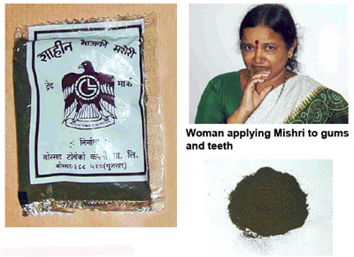
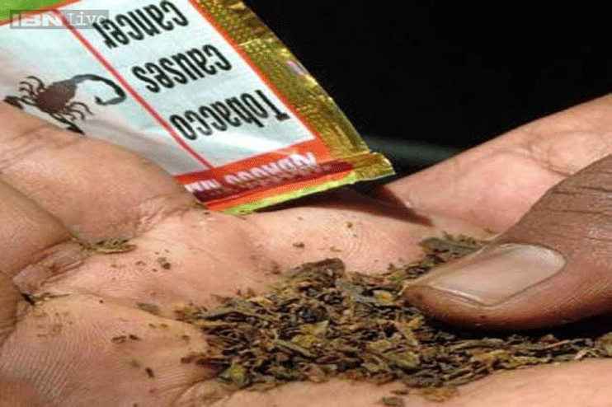
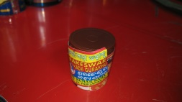
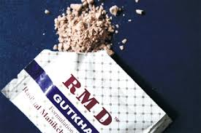
Chewing habits | Ingredients | significance
Mishri | Prepared by roasting tobacco on a hot metal plate until it is uniformly black and is then powdered. | Overall 22% of the villagers in Maharastra use Mishri, more often women (39%) than men (0.8%).
Zarda | Tobacco leaf boiled in water along with lime and spices until evaporation | Mostly used by tribes of south India
Gudakhu | It is a paste made of tobacco and molasses | Used predominantly by Bihar women
Gutkha | Prepared by crushing betel nut, tobacco and adding some sweet or savory flavour | It was originated from India, used by young people all over India

Slide 36
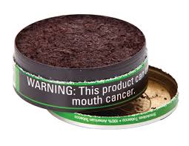
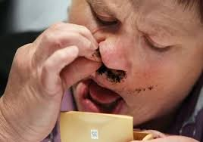
SNUFF:
Snuff is a type of smokeless tobacco.
Basically 2 forms
Moist type consisting of very finely cut tobacco which is used in the mouth
Dry type which is finely pulverized tobacco and is used orally or nasally.
Traditionally, inhaled or "snuffed" through the nose.
Mostly used by Gujarathi women.

Slide 37
Madani AH et al provided strong evidence that gutkha, supari, areca nut, chewing tobacco and mishri are independent risk factors for oral cancer.
Indian J Public Health 2012: 54; 57-61
Li WJ 2012 reported that 174(8%) smokers out of 1993 had oral cancer, 138 (9.2%) habitual drinkers out of 1356 had oral cancer and 126(18.3%) betel nut chewers out of 564 had oral cancer in a Chinese province.
J Oncol 2011;1: 1-6

Slide 38
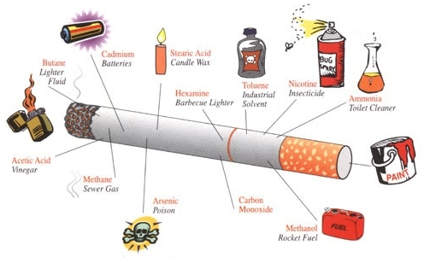
Smoking tobacco:
A) Cigarette:
It consists of shredded or reconstituted tobacco processed with hundreds of chemicals.
1 – 1.4mg of nicotine, 19-27 mg of tar.
Predominant form of tobacco used worldwide.
About 30% of the tobacco grown in India goes into cigarette production.
2-6% of men smoke cigarettes in rural India.

Slide 39

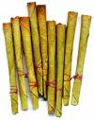
Beedi:
Most popular form of tobacco.
0.2 to 0.3 grams of sun dried tobacco flakes are hand rolled in a rectangular piece of temburni or tendu leaf and tied with a thread.
60mm and 80mm in length,
1.7-3 mg of nicotine and 45 – 50 mg tar.
Produces less smoke because of coarse tobacco particles.
12% - 62% smoke beedi.
Contains more hydrogen cyanide, carbon monoxide, ammonia & phenols than cigarettes.

Slide 40
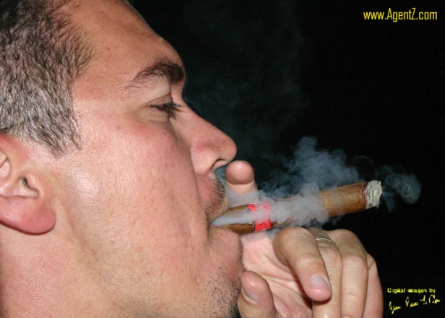
CIGAR:
A tightly rolled bundle of dried and fermented tobacco, one end of which is ignited so that its smoke may be drawn into the smoker's mouth through the other end.
Cigars from Cuba are particularly famous.
It is made of air cured, fermented tobacco.
Expensive, used in urban places.

Slide 41
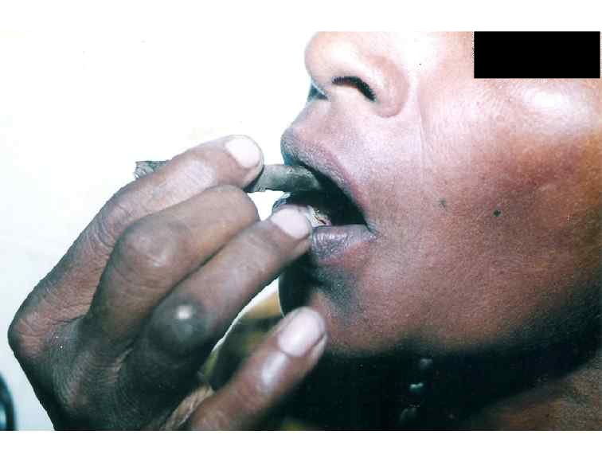
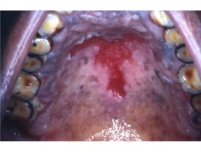
Reverse chutta smoking:
The lighted end - inside the mouth.
Seen in coastal areas of Andhra Pradesh, especially Vishakhapatnam and Srikakulam districts and in parts of Orissa.
More often practiced by women(62%).
The temperature reaches upto 58º C.

Slide 42
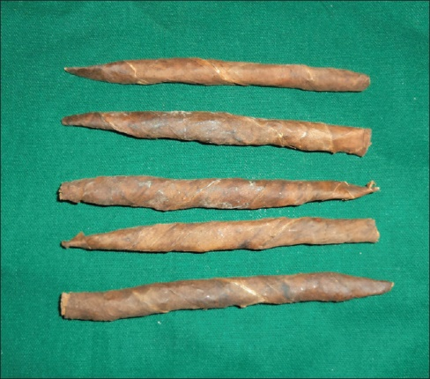
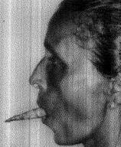
Dhumti:
It is a kind of conical cigar made by rolling tobacco in the leaf of a jack fruit tree / banana leaf.
Smoked by 4% of the population in Goa.
Dhumti reverse smoking is seen in Andhra Pradesh .

Slide 43
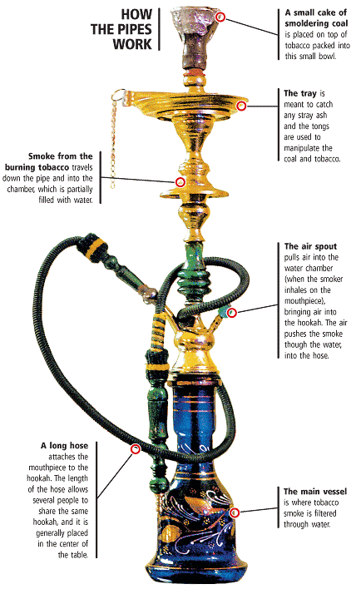
Hookah:
It is a Indian water pipe or Hubble- bubble.
Used in places with strong Moghul culture influence.
It corresponds with the introduction of tobacco to India.
The tobacco smoked is drawn through the water in the base of the hookah which cools and filters the smoke.
Practiced by 4-18% of the people in North India.

Slide 44
Subhapriya R et al (2007) reported that Pan chewing, smoking and alcohol consumption habits showed increasing risk with increase in frequency of disease. Addition of alcohol to other habits also enhanced the risk for oral cancer.
Eur J Cancer Prev 2007;16(3):251-6
Muwonge R et al (2007) reported that tobacco chewing was the strongest risk factor associated with oral cancer. Among men, 35% of oral cancer is attributable to the combination of smoking and alcohol drinking and 49% to pan-tobacco chewing. Among women, chewing and poor oral hygiene explained 95% of oral cancer.
Oral Oncol 2007;2(1):12-16

Slide 45
AGENT FACTORS:
  Physical agents
  Chemical agents
  Mechanical Factors
  Biological agents
  Nutritional agents
Physical agents:
Continuous heat
Sunlight
Ultraviolet radiation
Ionizing radiation
Solar radiation

Slide 46
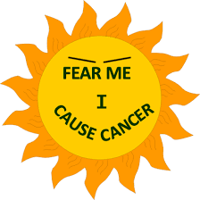
Sunlight and other ionizing radiation present in the environment play a vital role in the causation of oral cancer.
Squamous cell carcinoma and basal cell carcinoma are common in males, who are exposed to outdoor work like farmers, sailors.
Continuing heat due to severe chutta smoking may cause oral cancer, which is usually seen in coastal areas of AP can lead to oral cancer.
An area of white leukoplakic area is the earliest lesion observed.

Slide 47
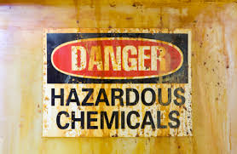
Chemical Agents:
Benzopyrine and its derivatives
Nitrosamines, Ethionine
Polycyclic Aromatic hydrocarbons
Aromatic amines
Azodyes
Alpha toxin
Others – Nicotine, Phenacetin
Cigarette smokes contains more than 15 carcinogens which includes Benzopyrine and its derivatives.
Nicotine in tobacco leads to habituation and is addictive.
Alpha toxin is considered as carcinogen.

Slide 48
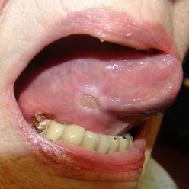
Mechanical Factors:
Chronic irritation/friction/trauma results in cancerous changes.
Ill fitting dentures
Over hanging fillings
Sharp tooth cusp
Broken teeth
Ragged teeth

Slide 49

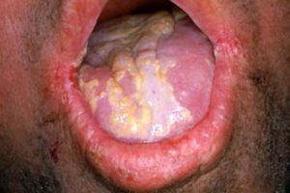
Biological Agents:
HIV virus
Syphilis
Hepatitis B virus --- Patients with hepatitis are more prone to develop hepatic carcinoma in future
Epstein-barr virus (EBV) - causative agent for Burkitt’s lymphoma, which may develop in the oral cavity.
Candida albicans.

Slide 50
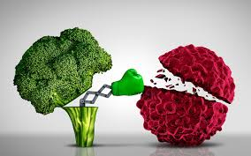
Nutritional Agents:
Deficiency of proteins, vitamins and minerals have a role in the initiation of oral cancer.
Malnutrition leads to decreased immunity and may lead to cancer.
Oral cancer is commonly found in low socio-economic state, hence correlation has been drawn with the nutritional status.
Protective factors- vegetable consumption, fish intake and fruits with Vitamin A, beta carotene & Vitamin C.

Slide 51
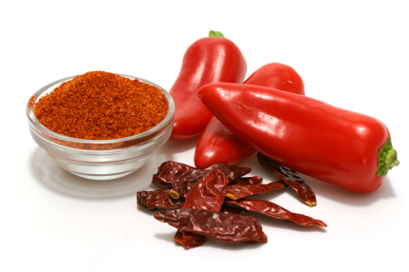
Plummer-Vinson syndrome- manifestation of Iron deficiency anemia.
Decrease in Cu, Zn & Mn → decreased antioxidant nutrients
                Increase in production of tumor enhancing free radicals
Red chilli powder – a risk factor
Effect was dose-dependent
<75g/consumption unit/month →150g/consumption unit/month
Risk increased from 1 to 4 fold

Slide 52
In developed countries the main risk factors for cancers of the oral cavity, pharynx and esophagus are alcohol and tobacco, and up to 75% of such cancers are attributable to these two lifestyle factors .
Overweight and obesity are established risk factors specifically for adenocarcinoma (but not squamous cell carcinoma) of the oesophagus.
Kaugers GE et al. Cancer 1992;70:2579-85.
In developing countries, around 60% of cancers of the oral cavity, pharynx and oesophagus are thought to be a result of micronutrient deficiencies related to a restricted diet that is low in fruits and vegetables and animal products.
Narasannavar A et al. J Dent Med Sci 2014;13:31-4.

Slide 53
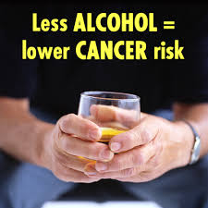
Alcohol is an independent risk factor.
Synergistic effect of tobacco and alcohol.
Account for 75% of all oral & pharyngeal cancers & has been implicated in the formation of multiple primary cancer sites.
The risk in alcohol consumers depends on the type and amount consumed.
Sujatha D et al. Asian Pacific J Cancer Prev 2012; 13: 1633-1637.
Dehydrating effect on mucosa
Increased mucosal permeability
Increases effects of potential carcinogens
Solubilizing tobacco
Nutritional deficiency

Slide 54
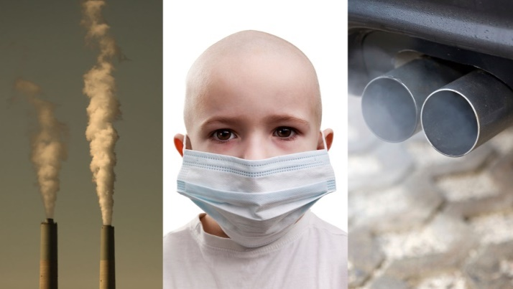
Environmental factors:
Air pollution has resulted in inclusion of certain harmful chemical substances into the atmosphere.
Eg Acrylonitrite, Alkylsulphates, Aromatic amines etc.
The prevalence of oral cancer may be directly associated with a high degree of industrialization.
Exhaust fumes containing Benzopyrine and other polycyclic hydrocarbons in the atmosphere can cause cancer.
Uranium miners, radiologists, workers in the nuclear plants are more prone for cancerous changes in the body.
Huebner WW et al. Epidemiology1992;3(4):300-9.
Schildt EB et al. Oncol Rep1999;6(2):317-20.

Slide 55
PREVENTION
Global initiatives in the prevention of oral cancer:
The CRETE Declaration on Oral Cancer Prevention 2005
WHO Framework Convention on Tobacco Control (FCTC)
Bloomberg Initiative to reduce Tobacco use

Slide 56
Primary Prevention
Eliminate habits of smoking, chewing tobacco, betel quid, khaini, reverse smoking and alcohol.
Mass media Symposia/ seminars
Group discussion
Individual counselling
Peer group pressures and diversions
Add in school curriculum and motivate teachers
Change life styles
Improve oral hygiene
Reduce sunlight exposure
High fruits/ vegetables

Slide 57
Secondary prevention
Mass surveys.
Periodic medical examination.
Maintenance of dental health care.
Early detection, biopsy and treatment.
Proper follow-up after surgery/ radiotherapy
Discretion in use of diagnostic/therapeutic X-ray / radiation.

Slide 58
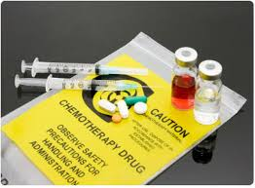
Tertiary prevention
Utilization of dental services
Provision of dental services
Chemotherapy
Radiotherapy
Surgery
Plastic surgery
Speech therapy

Slide 59
PREVENTION AND CONTROL
Approaches to Public Health:
1. Regulatory Approach.
2. Service Approach.
3. Educational Approach.

Slide 60
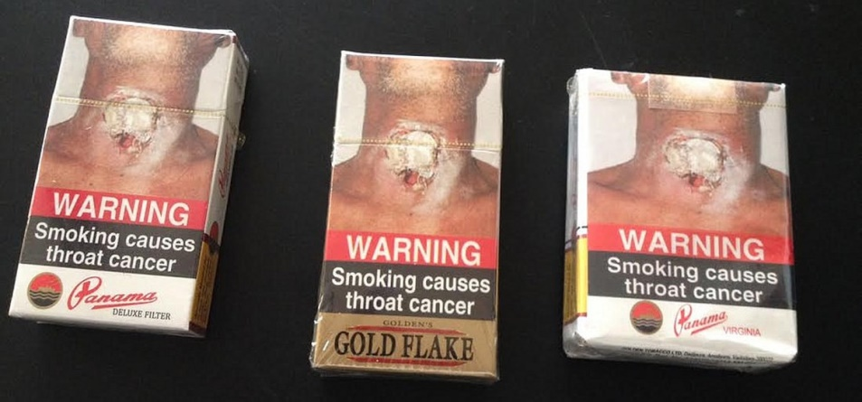
1. Regulatory Approach
1590- First governmental edict against tobacco was derived in Japan.
1604- King James of England increased tax on tobacco by 400% .
1975- In India, Cigarette Act 1975 made it necessary to print warnings on cigarette packets.

Slide 61
REGULATORY/ LEGISLATIVE MEASURES
Ban tobacco and alcohol use
Ensure adequate legislation
Ensure warnings on products sold
Increase cost
Avoid glorification of products through advertisements.

Slide 62
2. Service Approach
Services provided by the professionals – Screening.
In order to be suitable for screening, certain criteria have to be met
* Disease is serious, yet treatable in early stages.
* Facilities for diagnosis and treatment exists.
* Natural history of disease is known.
* Screening tool is inexpensive and safe.
Dentists & primary health care workers – satisfactory validity & reliability.
A 3rd of all cancers – first seen by the dentist.

Slide 63

3. Educational Approach
Dentists have an important role in helping patients quit tobacco as they are in an ideal position to counsel the patients and follow up.
Dentists must recognize that every interaction on tobacco use, however brief, can lead to a significant change in the patient’s attitude and behaviour.

Slide 64
Tobacco Cessation
5A method:
Ask
Advise
Assess
Assist
Arrange

Slide 65
The 5 R’s of Motivational Intervention for patients unwilling to Quit :
Relevance of quitting
Risks of continuous tobacco usage
Rewards of quitting
Roadblocks to quitting
Repetition at each visit

Slide 66
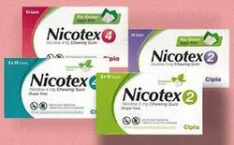
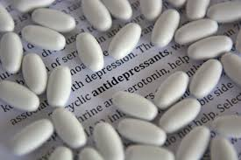
Pharmacotherapy:
Nicotine Replacement Therapies
Antidepressants

Slide 67
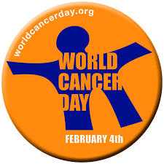
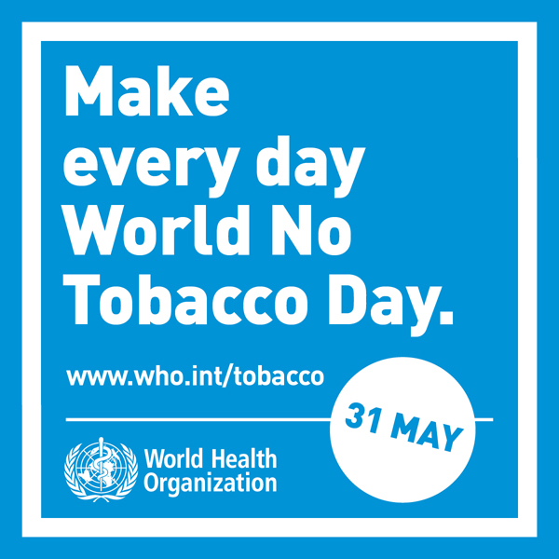
Important days to remember regarding oral cancer
World Cancer Day - 4th Feb
World No Tobacco Day – 31st May

Slide 68
CONCLUSION
The suffering, disfigurement and death due to oral cancer are easily avoidable since the factors associate with the disease have been long identified.
This feature coupled with the finding that oral cancer is generally preceded by precancerous lesions provides an excellent opportunity for early detection and prevention.
In a diverse country like India, tobacco control strategies should be tailored to the prevalent habits, culture, and educational levels of specific population groups to successfully usher in a non-tobacco generation in the near future.

Slide 69
REFERENCES
Park K. Park’s Textbook of Preventive and Social Medicine.22nd ed, Banarsidas: Jabalpur: 2013.
Hiremath SS. Textbook of Public Health Dentistry, 3rd ed. New Delhi: RELX India Pvt. Ltd.;2016.
Marya CM. A Textbook of Public Health dentistry. New Delhi: Jaypee Brothers;2011.
Peter S. Essentials of Public Health Dentistry, 5th ed. New Delhi: Arya Publishers: 2008.
S.R. Prabhu. Oral Diseases in the Tropics.1992; Oxford university Press.
.

Slide 70
Dunning JM. Principles of Dental Public Health. 1st ed: Harvard university press: london: 1986.
Madani AH, Dikshit M, Bhaduri D. Risk for Oral Cancer Associated to Smoking, Smokeless and Oral Dip Products. Ind J Public Health 2012: 54; 57-61.
Sharma P, Saxena S, Aggarwal P. Trends in Epidemology of Oral Squamous Cell Carcinoma in Western UP- A Institutional Study. Indian J Dent Res:2010: 21(3);316- 319.
Lin WJ, Jiang WJ, Wu SH, Chen FJ. Smoking Alcohol Betel Quid and Oral Cancer: A Prospective Cohort Study. J Oncol 2011: 1-6.

Slide 71
GlOBOCAN 2012: Word Cancer Facts – International Agency for Research on Cancer – WHO; 2012
Muwonge R, Ramadas K, Sankila R, Thara S Thomas G, Vinoda J, Sankaranarayanan R. Role of tobacco smoking, chewing and alcohol drinking in the risk of oral cancer in Trivandrum, India: A nested case-control design using incident cancer cases. Oral Oncol 2007;2(1):12-16.
Subhapriya R, Thangavelu A, Mathavan B, Ramachandran CR, Nagini S. Assessment of risk factors for oral squamous cell carcinoma in Chidambaram, Southern India: a case-control study. Eur J Cancer Prev 2007:16(3);251-6.

Slide 72
Sujatha D, Hebbar PB, Pai A. Prevalence and correlation of oral lesions among tobacco smokers, tobacco chewers, areca nut and alcohol users. Asian Pacific J Cancer Prev 2012; 13: 1633-1637.
Sridharan G. Epidemiology, control and prevention of tobacco induced oral mucosal lesions in India. Indian J Cancer 2014;51:80-5.
Mehrotra R, Pandya S, Chaudhary A, Kumar M, Singh M. Prevalence of Oral Pre-malignant and Malignant Lesions at a Tertiary Level Hospital in Allahabad, India. Asian Pacific J Cancer Prev, 2008;9:263-266.
Huebner WW, Schoenberg JB, Kelsey JL, Wilcox HB, McLaughlin JK, Greenberg RS, et al. Oral and pharyngeal cancer and occupation: a case-control study. Epidemiology 1992;3(4):300-9.

Slide 73
Schildt EB, Eriksson M, Hardell L, Magnuson A. Occupational exposures as risk factors for oral cancer evaluated in a Swedish case-control study. Oncol Rep1999;6(2):317-20.
Kumar BD, Tatapudi R, Reddy RS, Alapati S, Pavani K, Sai-Praveen KN. Various forms of tobacco usage and its associated oral mucosal lesions. J Clin Exp Dent 2016; 8(2): 172–177.
Sujatha D, Hebbar PB, Pai A. Prevalence and correlation of oral lesions among tobacco smokers, tobacco chewers, areca nut and alcohol users. Asian Pacific J Cancer Prev 2012; 13: 1633-1637.
Garcia-Pola Vallejo M.J., Martinez Diaz-Canel A.I., Garcia Martin J.M., Gonzalez Garcia M. Risk factors for oral soft tissue lesions in an adult Spanish population. Community Dent Oral Epidemiol 2002;30:277–285.

Slide 74
Kumar S, Debnath N, Ismail MB, Kumar A, Kumar A, Badiyani BK et al. Prevalence and Risk Factors for Oral Potentially Malignant Disorders in Indian Population. Advances in Preventive Medicine 2015;19:1-7.
Mathers CD, Loncar D. Projections of global mortality and burden of disease from 2002 to 2030. PLoS Med 2006;3(11):e442.
Global Adult Tobacco Survey GATS India 2009-2010. Ministry of Health and Welfare, Government of India.
Bobak M, Jha P, Nguyen S, et al. Poverty and smoking. In: Jha P, Chaloupka FJ, eds. Tobacco control in developing countries. Oxford: Oxford University Press, 2000.

Slide 75
Kaugars GE, Riley WT, Brandt RB, Burns JC, Svirsky JA. The prevalence of oral lesions in smokeless tobacco users and an evaluation of risk factors. Cancer 1992;70:2579-85.
Narasannavar A, Wantamutte AS. Prevalence of oral precancerous lesions and conditions among tobacco consumers in rural population around Belgaum. A community based cross sectional study. J Dent Med Sci 2014;13:31-4.
Gupta S, Singh R, Gupta OP, Tripathi A. Prevalence of oral cancer and pre-cancerous lesions and the association with numerous risk factors in North India: A hospital based study. Natl J Maxillofac Surg 2014; 5(2): 142–148.

